Slide 1

Robot Localization using Left Invariant EKF
MOBILE ROBOTICS FINAL PROJECT
BY: SAPTADEEP DEBNATH, ANTHONY LIANG, GAURAV MANDA, SUNBOCHEN TANG AND HAO ZHOU

Slide 2
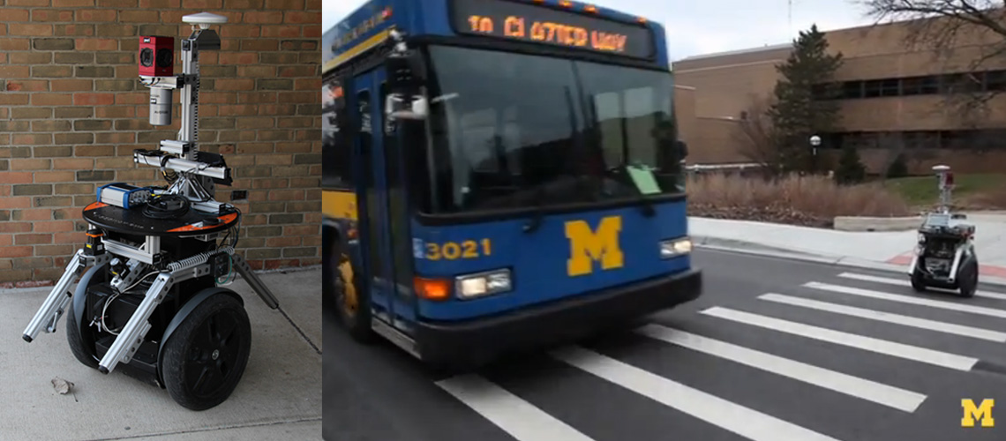
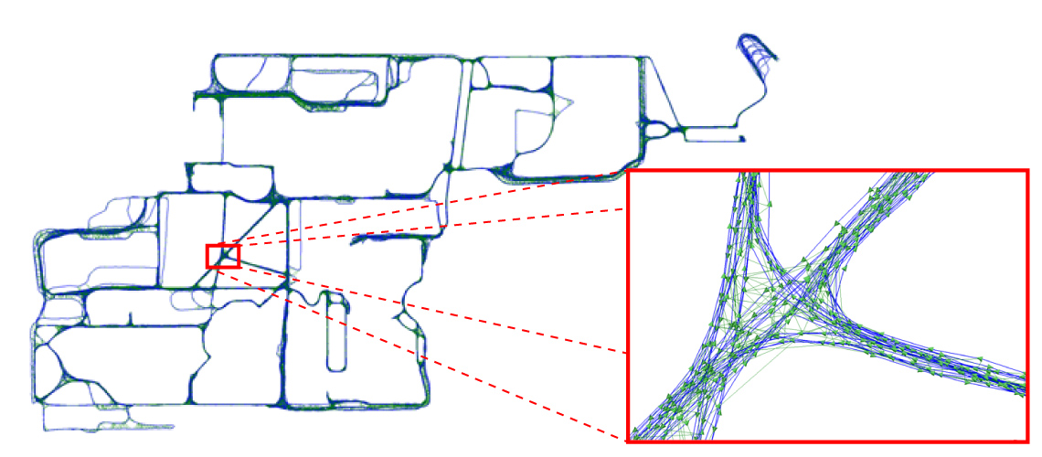
Dataset
Notes:
about what ALL types of data are available and what all are used

Slide 3
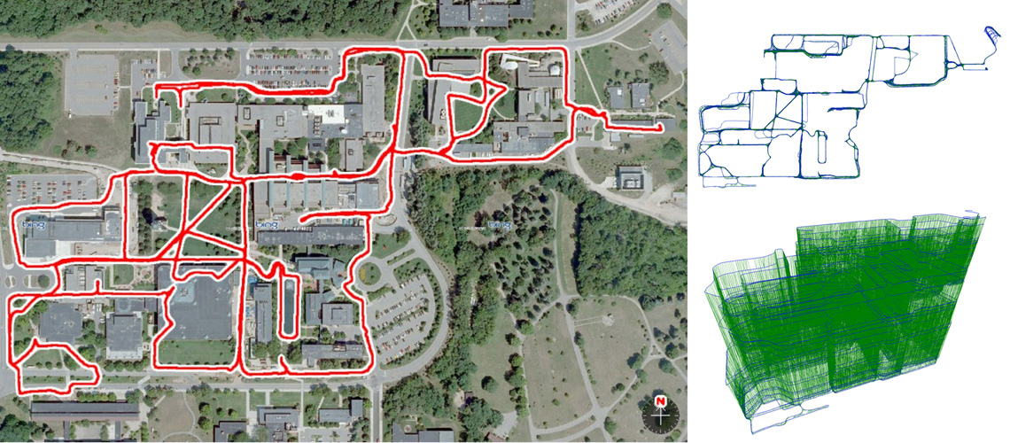
Idea
Notes:
About how the IMU data is corrected with GPS

Slide 4
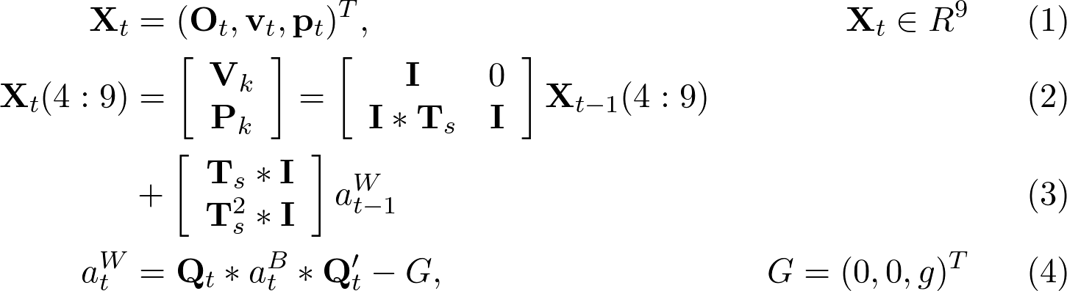
Extended Kalman Filter model
The system is given by
The orientation is propagated from the angular velocity and acceleration measurements using the madgwick filter.
Notes:
easy to implement a non linear model

Slide 5
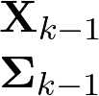
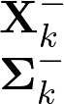
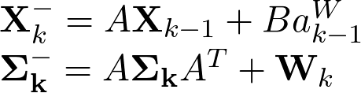
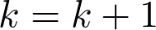
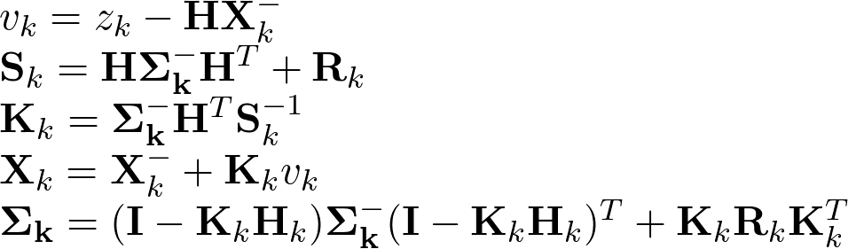
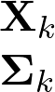
Extended Kalman Filter Flowchart
Prediction
Measurement
Prior
Update
Output
Notes:
Flowchart of data used

Slide 6
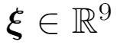
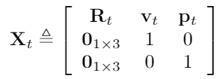
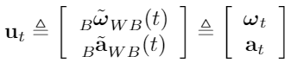
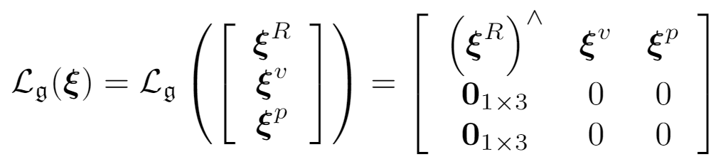
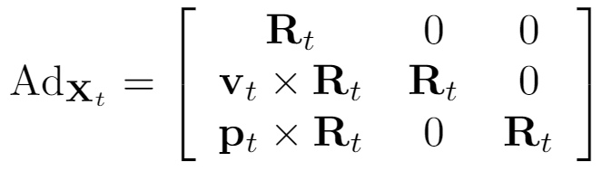
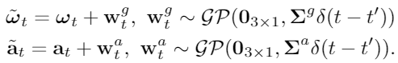
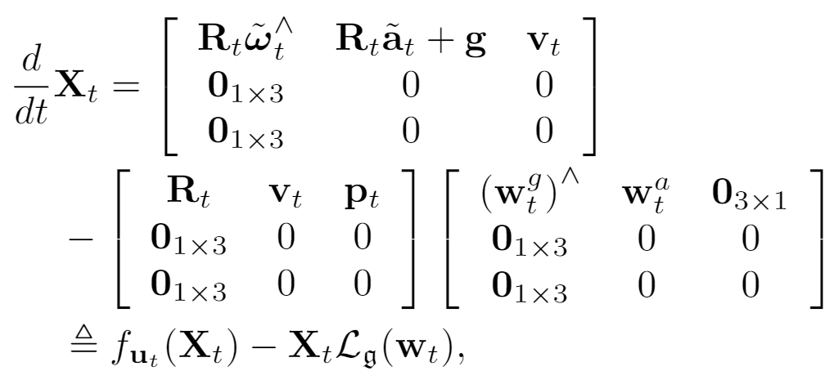
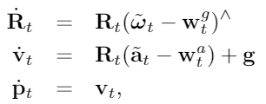
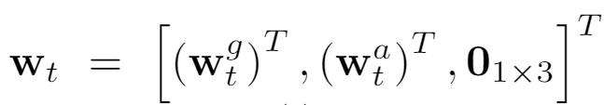
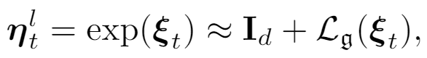
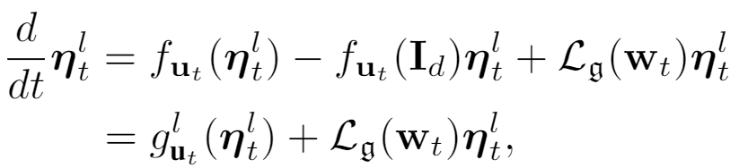
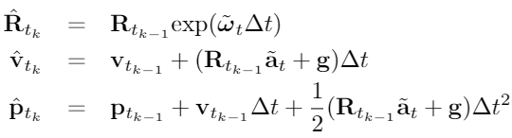
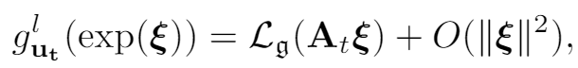
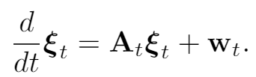
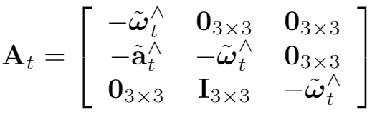
SE2(3) Left-Invariant EKF model
State Representation:
IMU dynamics:
(Gaussian
Noise)
Discretization
Given state in vector form
State and adjoint operator in Lie algebra form:
IMU dynamics with Lie group
noise vector:
First order approximation:
Left-invariant error dynamics:
Log-linear invariant error:

Slide 7
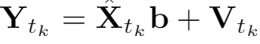
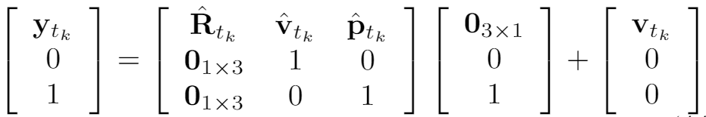
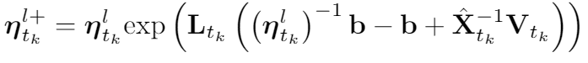
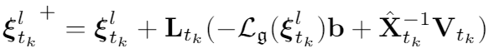
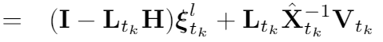
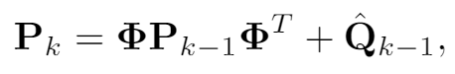
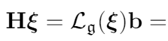
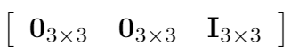
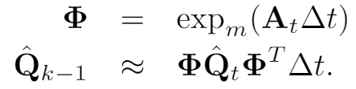
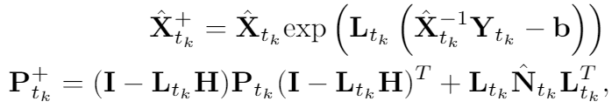
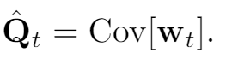
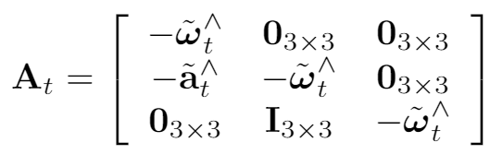
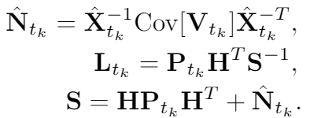
LI-EKF Final equations
Prediction by deterministic IMU dynamics
Correction by GPS measurement (left-invariant)
Discrete IMU dynamics:
Discrete covariance propagation
GPS measurement model
Innovation by invariant error:
Measurement Jacobian
Final equations:

Slide 8
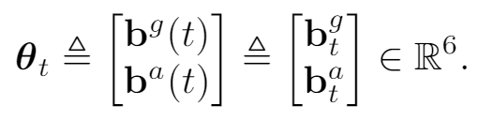
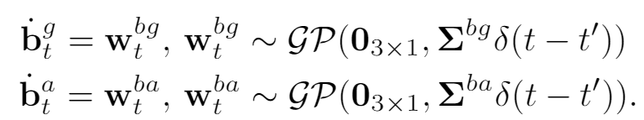
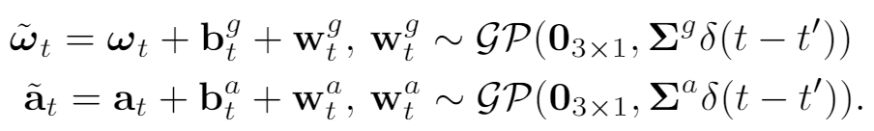
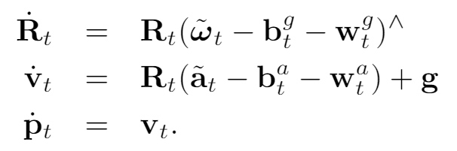
Including IMU bias
IMU bias: accumulated error in IMU measurements
Bias definition and dynamics:
Modified Measurement model with IMU bias
Modified IMU dynamics

Slide 9
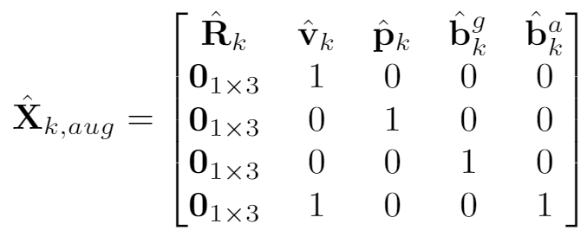
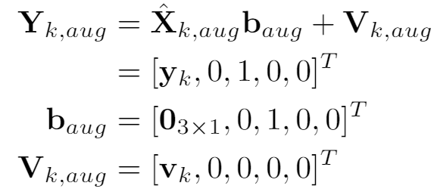
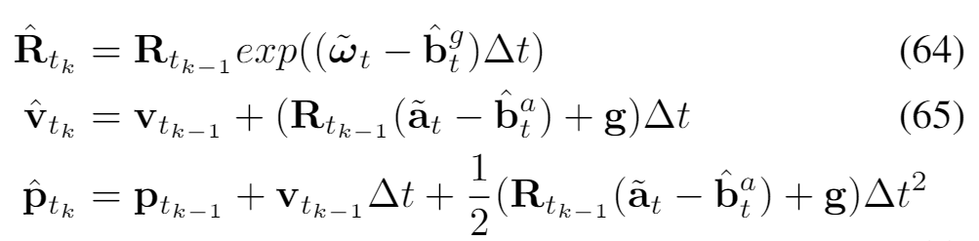
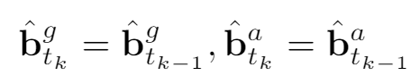
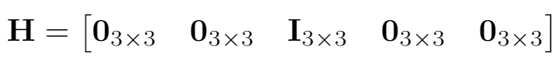
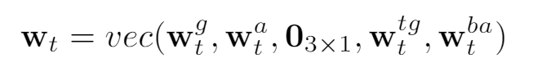
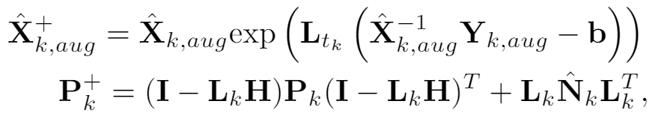
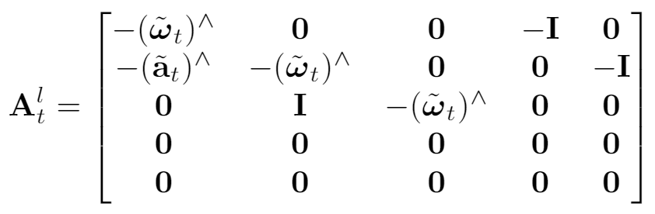



LI-EKF including IMU bias
Prediction step (zero-order hold integration)
Correction step (zero-order hold integration)
Lie algebra -> original state matrix
Bias dynamics -> bias state propagation
Discrete dynamics equations:
Augmented error term
Discrete covariance propagation
Augmented state and GPS measurement
Measurement Jacobian
Correction step equations:

Slide 10

Results
Trajectory based on the consumer-grade GPS on the robot overlaid on Google Maps.
Notes:
about what ALL types of data are available and what all are used

Slide 11


Results
Extended Kalman Filter
Left-invariant EKF
Notes:
about what ALL types of data are available and what all are used

Slide 12
Conclusions + Future Work
Reimplemented EKF and LiEKF algorithms to localize a mobile robot using GPS data for correction from the North Campus Long Term Vision Dataset
Obtained accurate trajectory results that are very similar to the ground truth pose information
Visualized trajectory of robot over time in a video and overlaid the results in Google Maps
Integrated IMU bias information with LiEKF implementation to achieve better performance
Future works include: improving results with IMU bias
Notes:
The trajectory produced by the LiEKF and EKF implements are practically identical to that on the GPS.

Slide 13
Thank you for listening!
Notes:
about what ALL types of data are available and what all are used

